Slide 1

Engineering Graphics
INT 109 P
Orthographic Views
Dr. Vikash Kumar

Slide 2
Introduction
Isometric view
Orthographic view
Step-by- step procedure
Study the isometric view and its detail carefully
Selection of Orthographic Views
Overall dimensions
Proportioning of dimensions
Block in views (Rectangular blocks for overall dimensions)
Center lines
Details of the object in all the views
Darken all the visible lines
Mark the dimensions

Slide 3
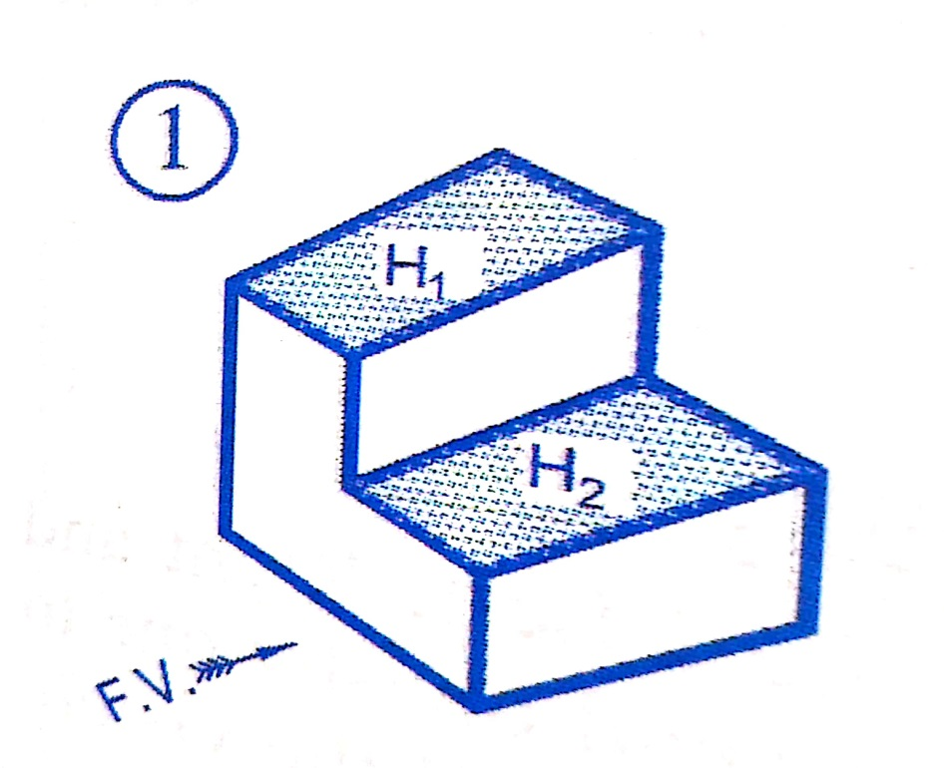
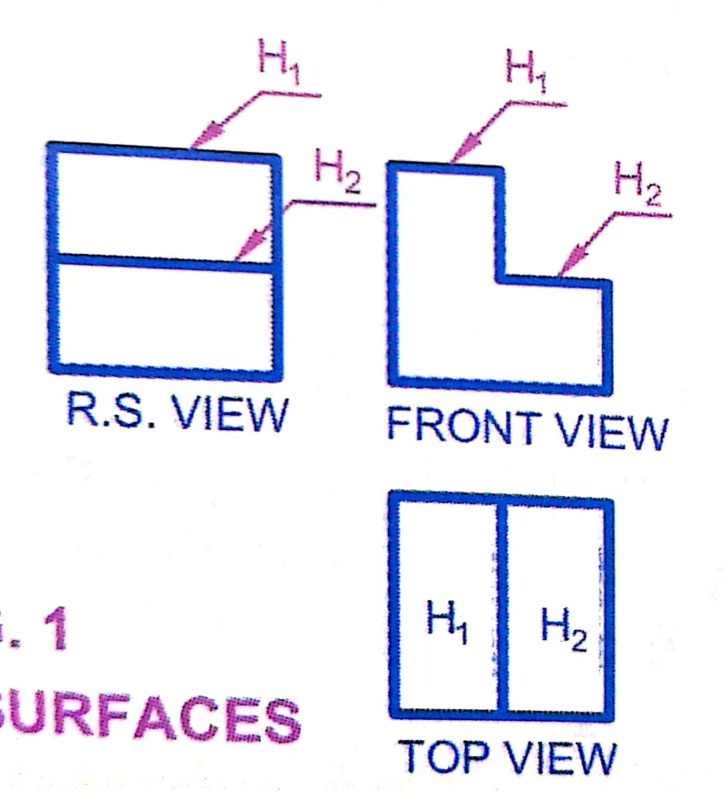
Orthographic views
Identification of surfaces
Parallel surfaces

Slide 4
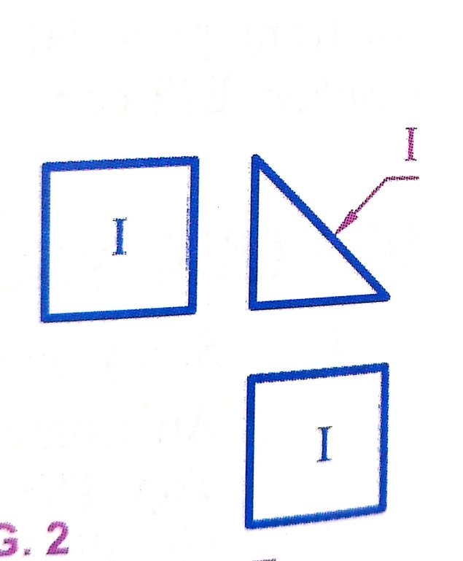
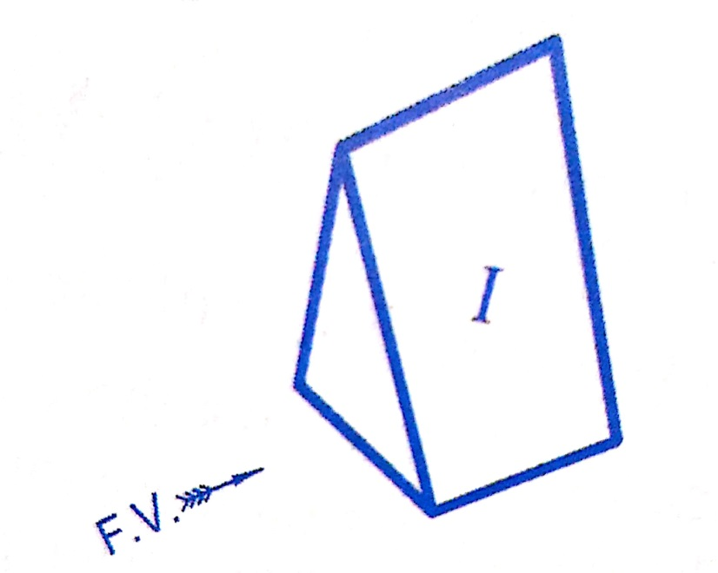
Orthographic views
Identification of surfaces
Inclined surfaces

Slide 5
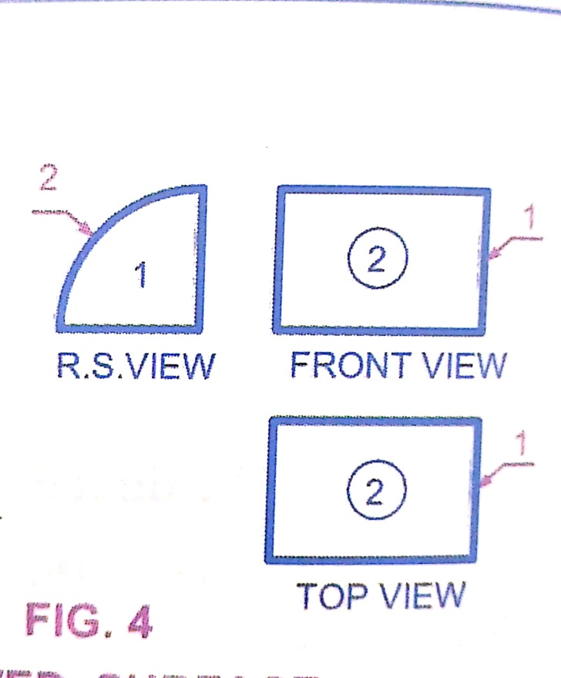
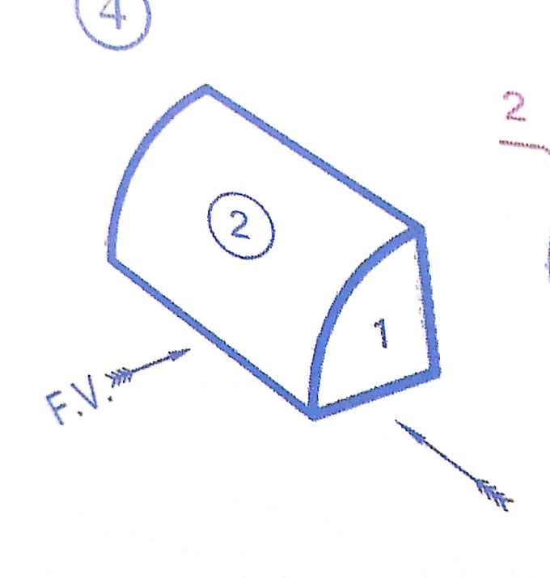
Orthographic views
Identification of surfaces
Curved surfaces

Slide 6
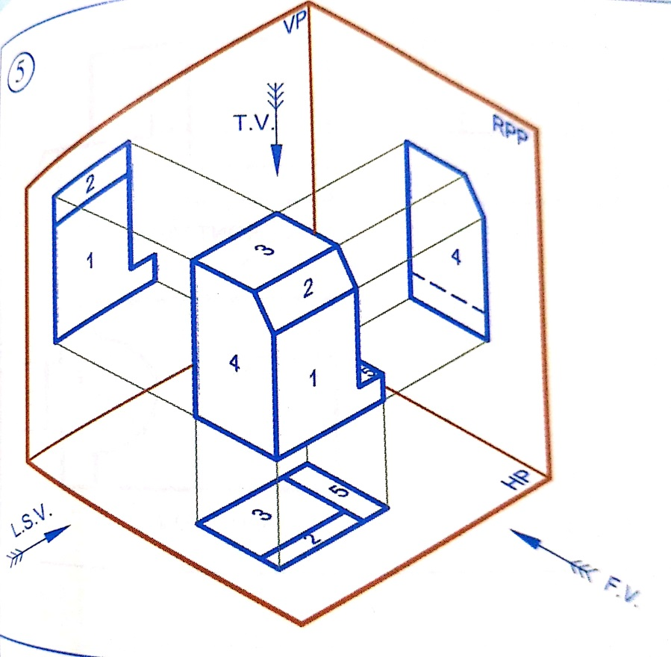
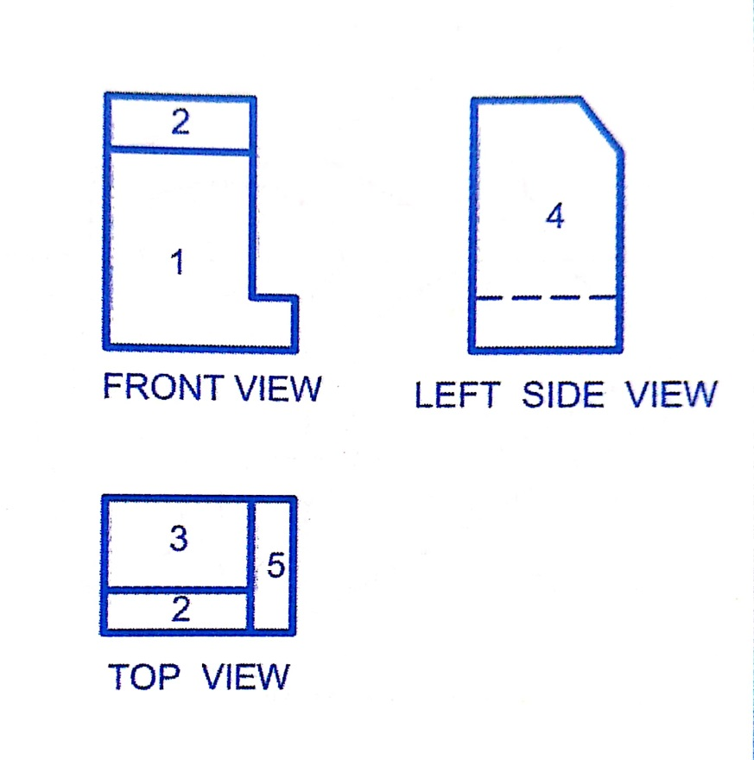
Orthographic views
Conversion of Isometric view to Orthographic views

Slide 7
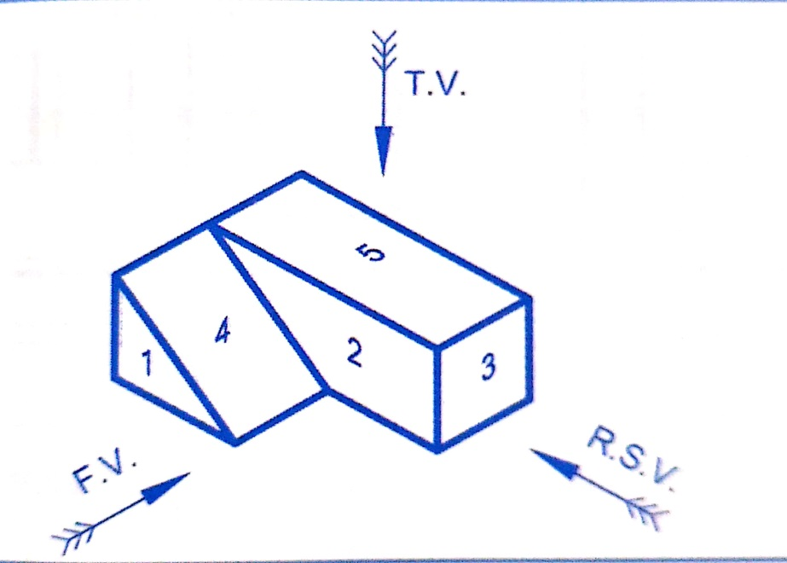
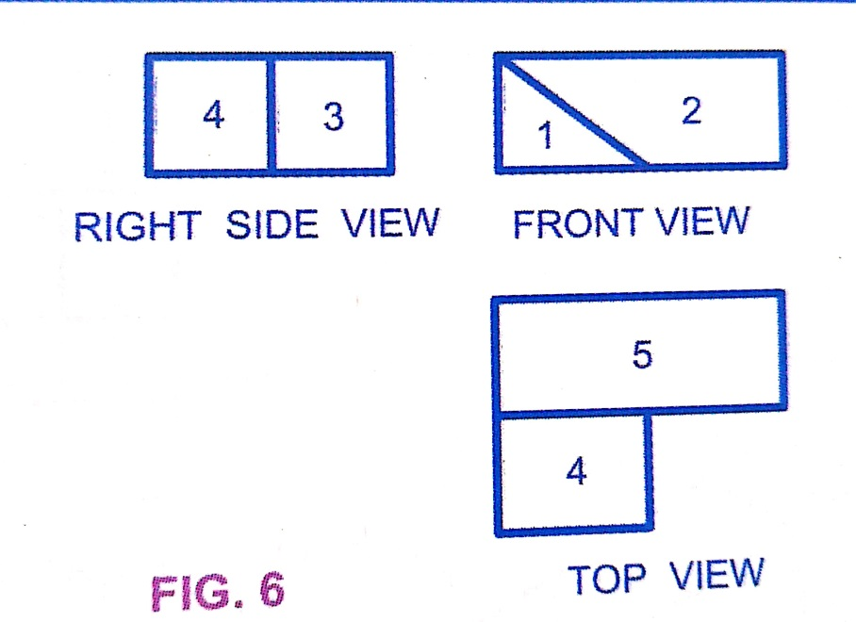
Orthographic views
Conversion of Isometric view to Orthographic views

Slide 8
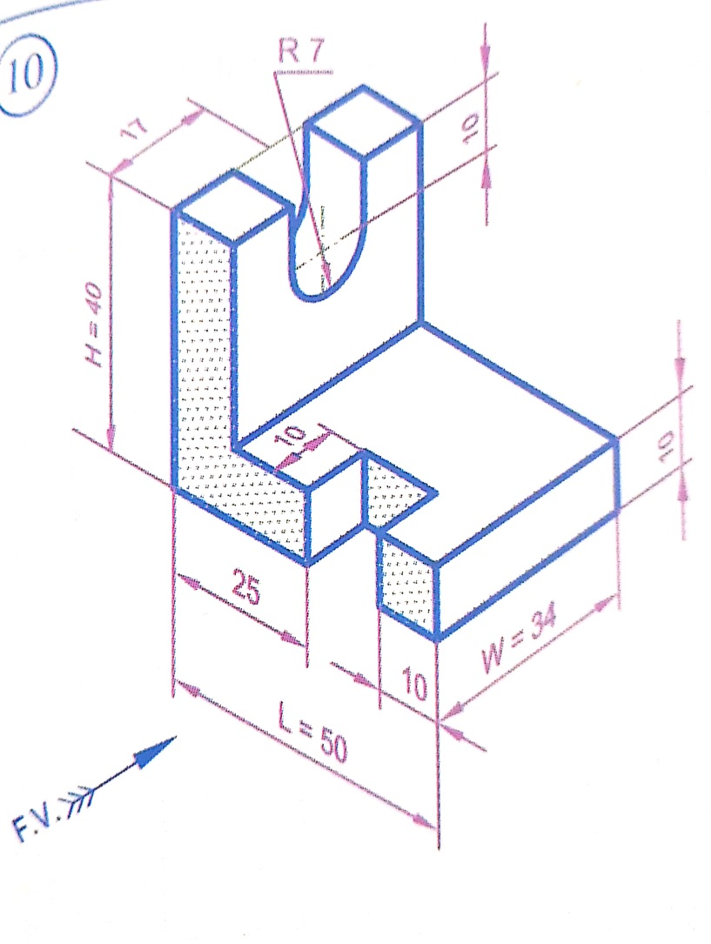
Orthographic views
Conversion of Isometric view to Orthographic views

Slide 9
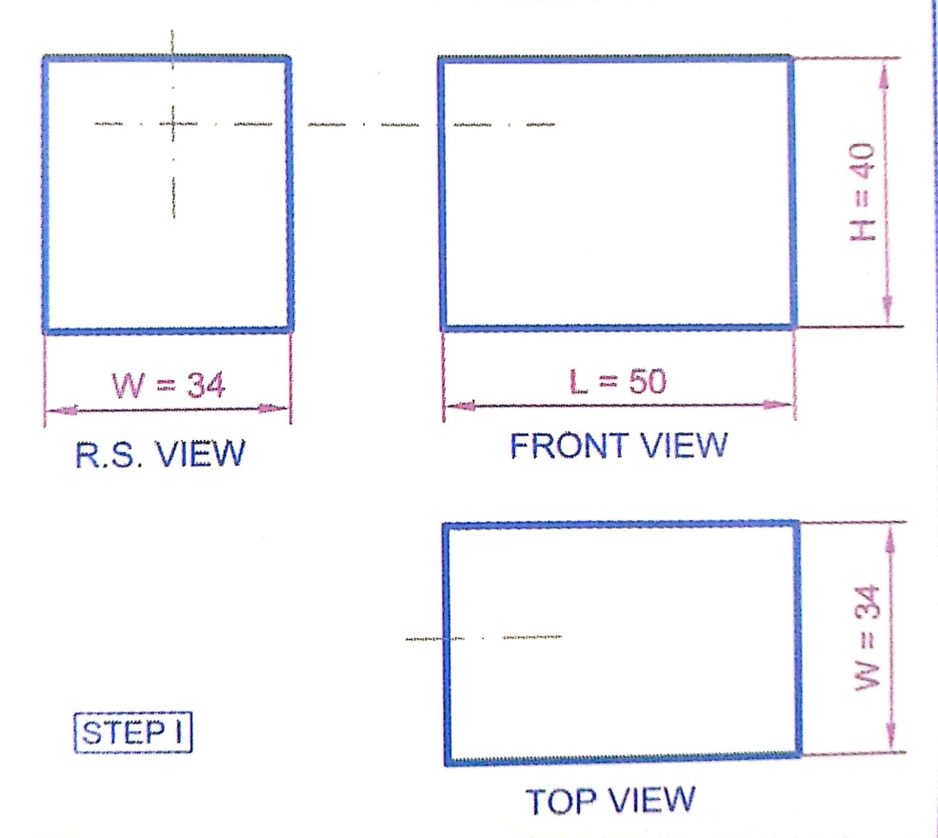
Orthographic views
Step I

Slide 10
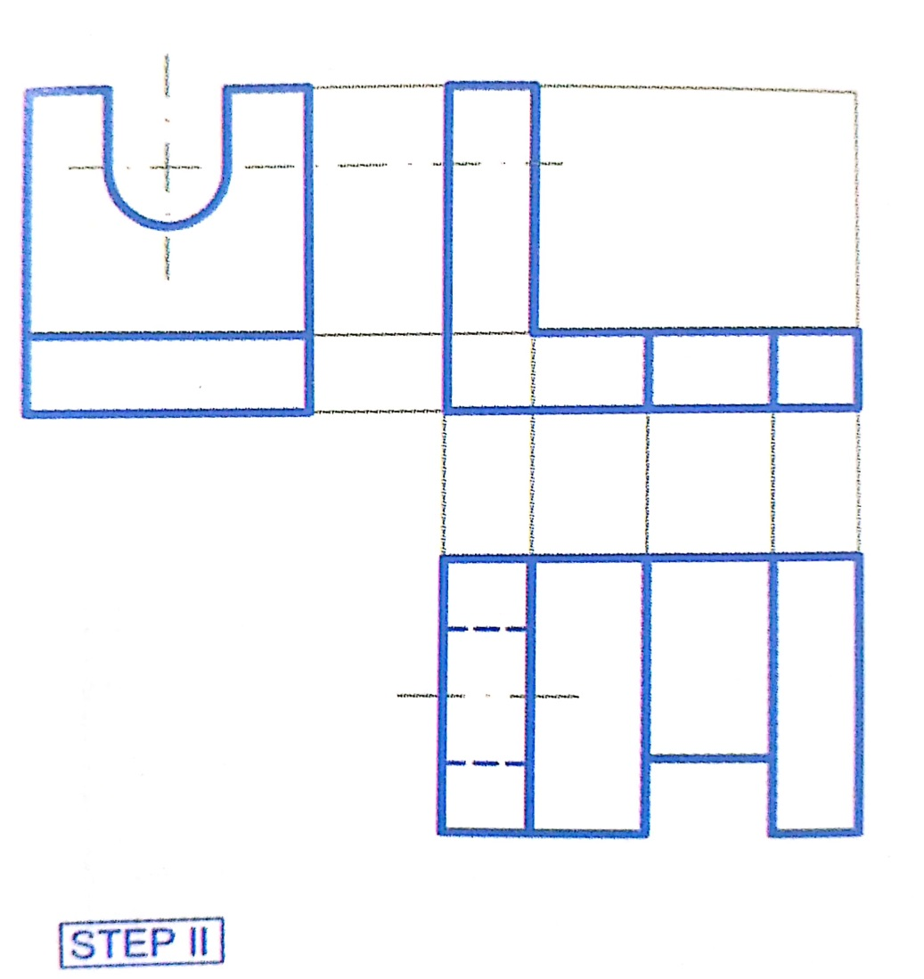
Orthographic views
Step II

Slide 11
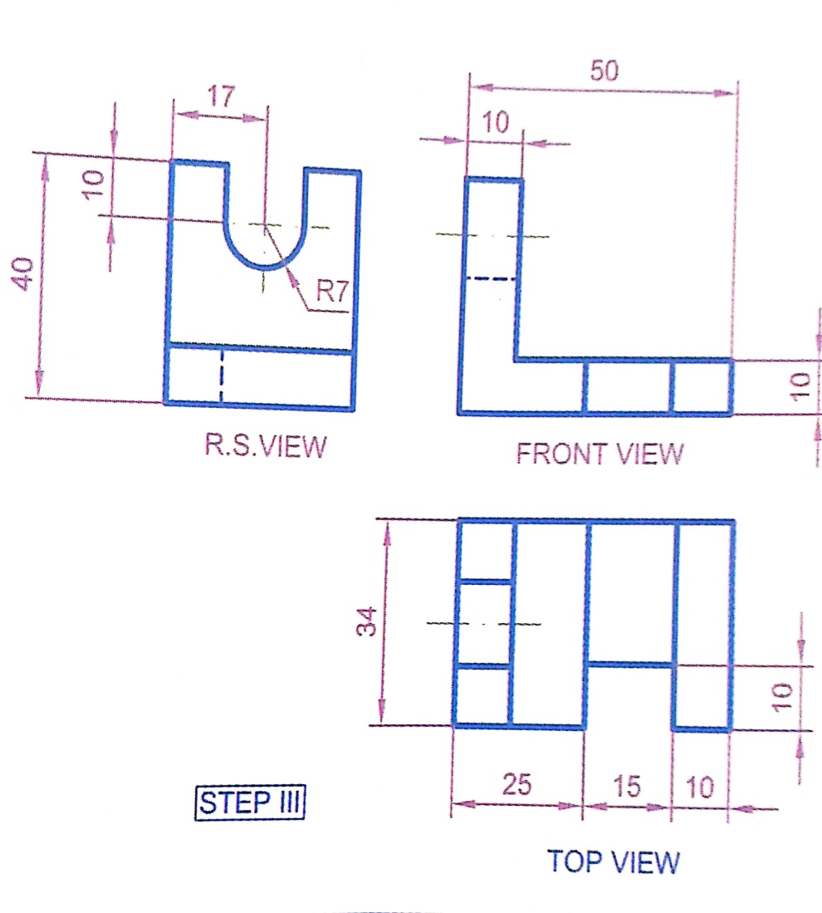
Orthographic views
Step III

Slide 12
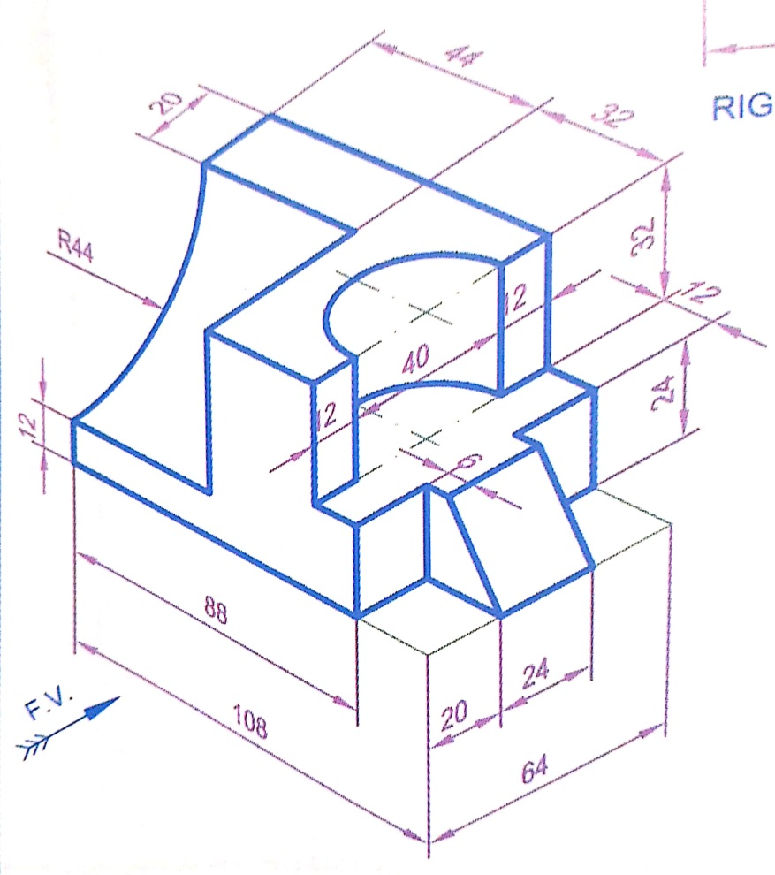
Orthographic views
Conversion of Isometric view to Orthographic views

Slide 13
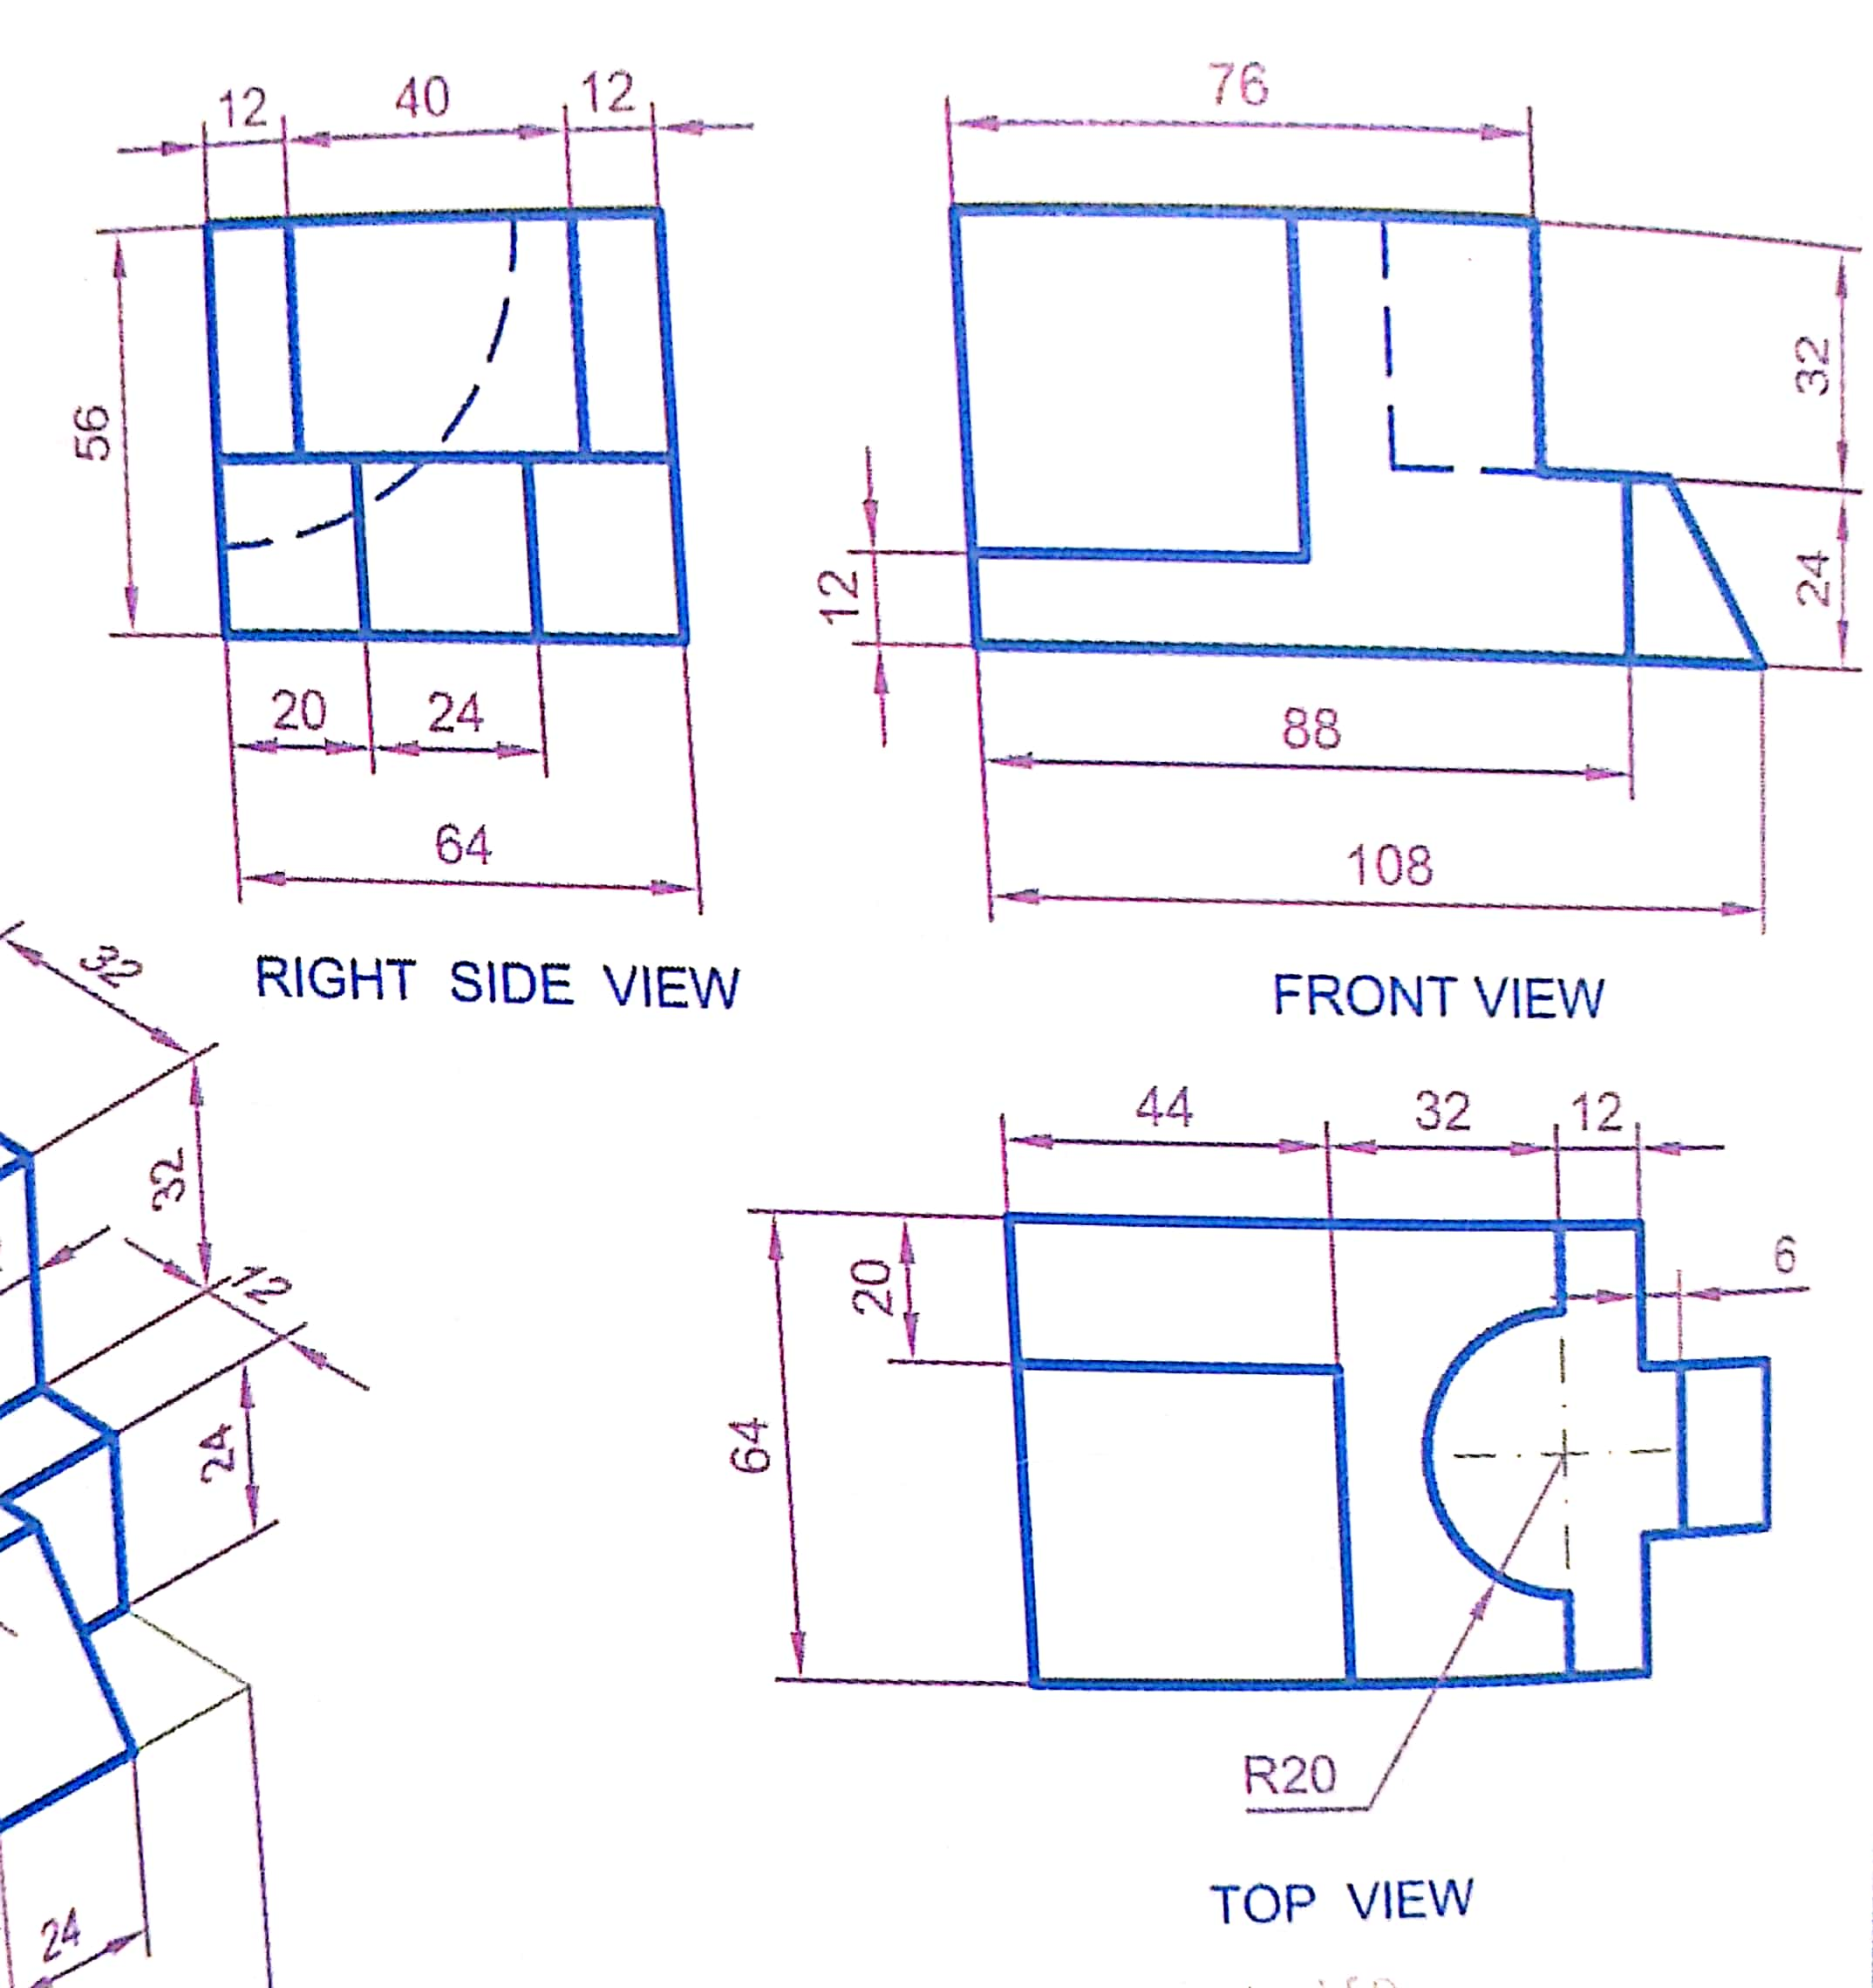
Orthographic views

Slide 14
Thank You

Slide 15
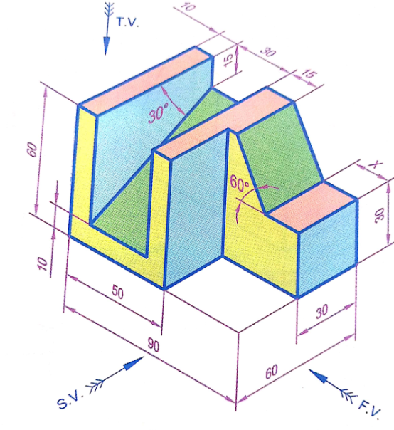

Slide 16
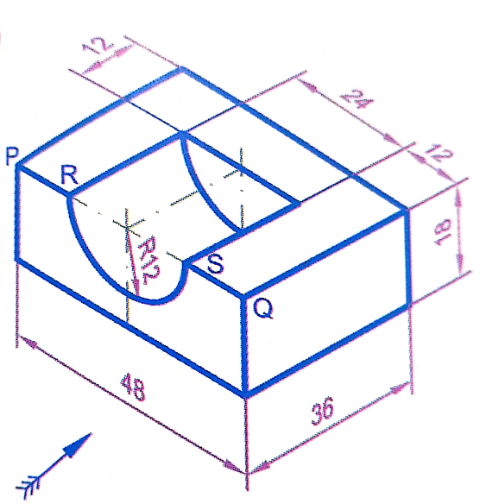

Slide 17
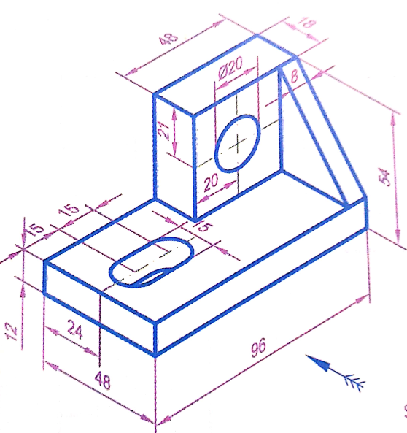

Slide 18
